Slide 1
Classification Exercise 1: Use ID3 algorithm to classify weather data from the “weather.arff” file. Perform initial preprocessing and create a version of the initial dataset in which all numeric attributes should be converted to categorical data.

Slide 2
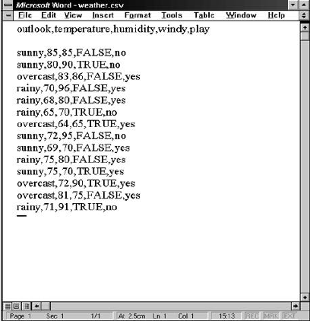
File Conversion: Weather Data in XLS

Slide 3
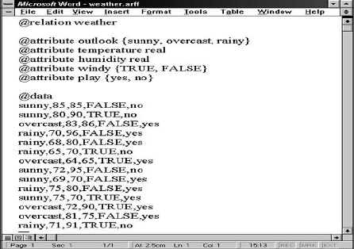
File Conversion : Weather Data in ARFF

Slide 4
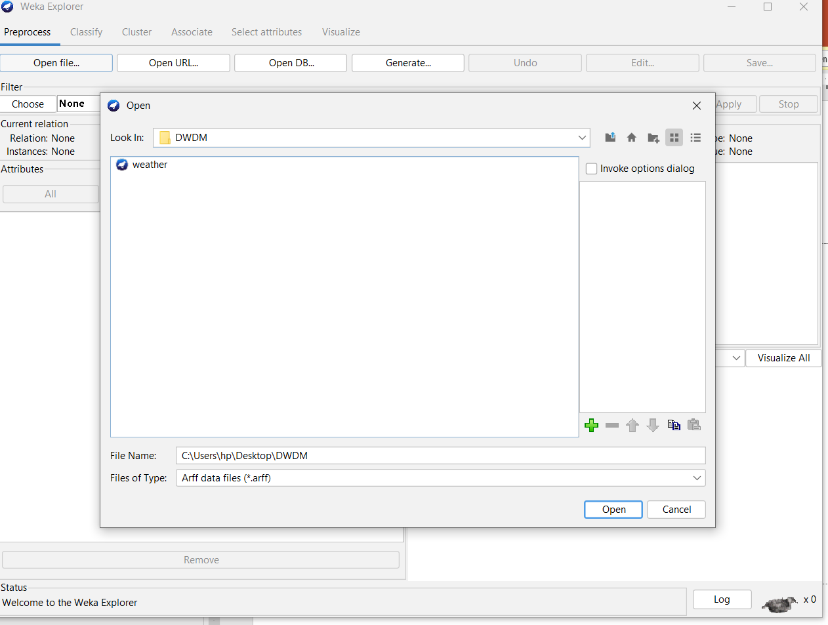
Opening file from a local file system : NOTE:WEKA automatically creates ARFF file from your CSV file.

Slide 5
Opening file from a URL/web site
https://storm.cis.fordham.edu/~gweiss/data-mining/weka-data/weather.arff

Slide 6
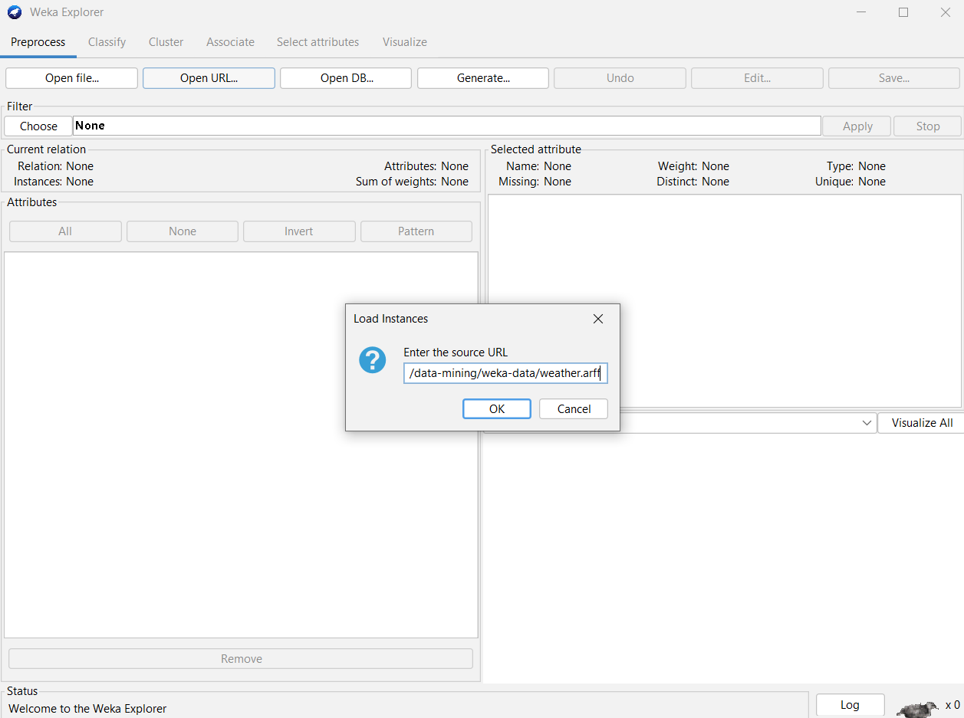
Opening file from URL/web site

Slide 7
Pre-processing window
Right-click anywhere in ‘Status box’, it brings up a menu with two options:
1. Available Memory that displays in the log and in ‘Status’ box the amount of memory available to WEKA in bytes.
2. Run garbage collector that forces Java garbage collector to search for memory that is no longer used, free this memory up and to allow this memory for new tasks

Slide 8
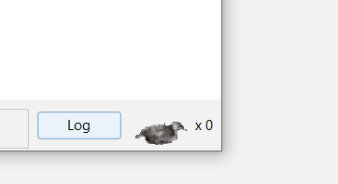
Log: The bird is WEKA status icon. The number next to ‘X’ symbol indicates a number of concurrently running processes. --When you loading a file, the bird sits down that means that there are no processes running. -- The number of processes besides symbol ‘X’ is zero that means that the system is idle.

Slide 9
Loading Data
Left panel of ‘Preprocess’ window shows the list of recognized attributes:
--No. is a number that identifies the order of the attribute as they are in data file,
--Selection tick boxes allow you to select the attributes for working relation,
--Name is a name of an attribute as it was declared in the data file.

Slide 10
Loading Data
The following statistics are shown in ‘Selected attribute’ box on the right panel of ‘Preprocess’ window:
--Name is the name of an attribute,
--Type is most commonly Nominal or Numeric, and Missing is the number (percentage) of instances in the data for which this attribute is unspecified,
--Distinct is the number of different values that the data contains for this attribute, and
--Unique is the number (percentage) of instances in the data having a value for this attribute that no other instances have.

Slide 11
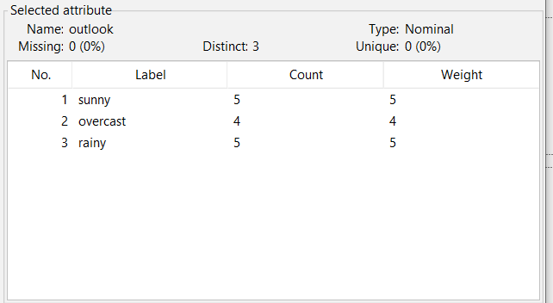
Loading Data

Slide 12
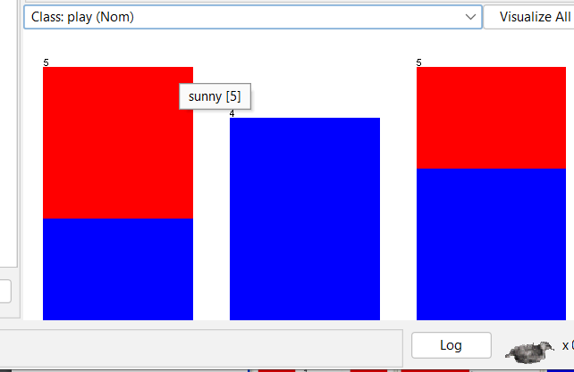
Visualizing
You can Visualize the attributes based on selected class. One way is to visualize selected attribute based on class selected in the ‘Class’ pull-down window, or visualize all attributes by clicking on ‘Visualize All’ button.

Slide 13
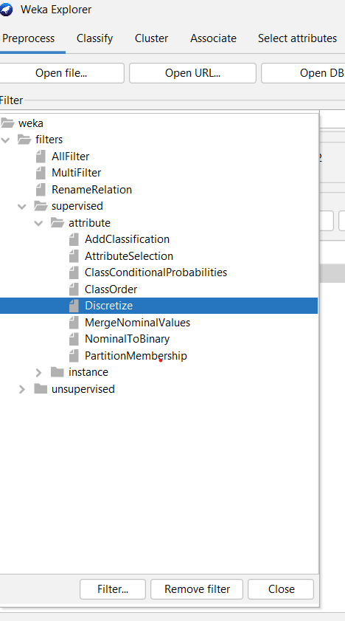
Setting Filters
Pre-processing tools in WEKA are called “filters”. WEKA contains filters for discretization, normalization, resampling, attribute selection, transformation and combination of attributes.

Slide 14
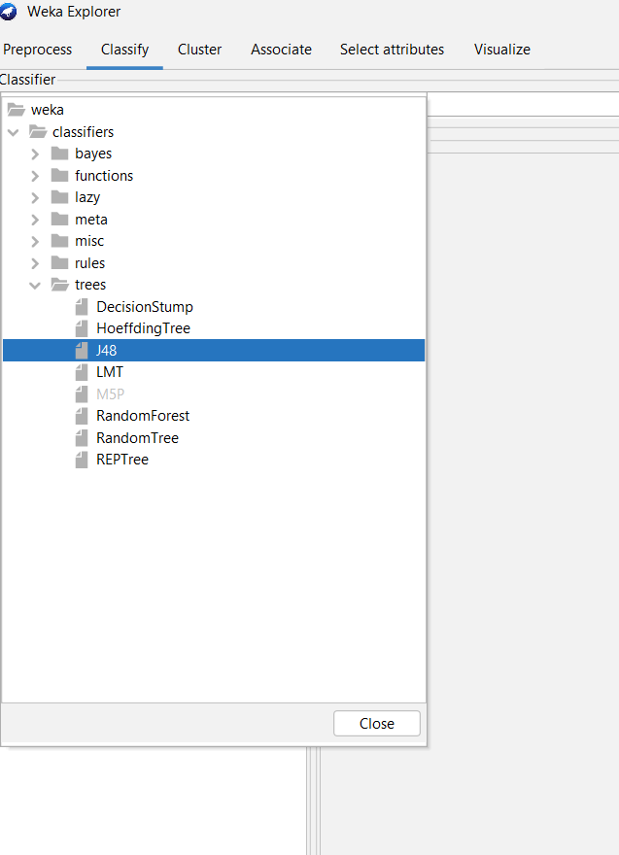
Building Classifiers
Classifiers in WEKA are the models for predicting nominal or numeric quantities.
--The learning schemes available in WEKA include decision trees and lists, instance-based classifiers, support vector machines, multi-layer perceptrons, logistic regression, and bayes’ nets.
--“Meta”- classifiers include bagging, boosting, stacking, error-correcting output codes, and locally weighted learning.

Slide 15
Setting Test Options
The test options that available to you are
Use training set. Evaluates the classifier on haw well it predicts the class of the instances it was trained on.
Supplied test set. Evaluates the classifier on how well it predicts the class of a set of instances loaded from a file. Clicking on the ‘Set…’ button brings up a dialog allowing you to choose the file to test on.
Cross-validation. Evaluates the classifier by cross-validation, using the number of folds that are entered in the ‘Folds’ text field.
Percentage split. Evaluates the classifier on how well it predicts a certain percentage of the data, which is held out for testing. The amount of data held out depends on the value entered in the ‘%’ field.
Check ‘Percentage split’ radio-button and keep it as default 66%.

Slide 16
Classifier Evaluation Options
1. Output model. The output is the classification model on the full training set, so that it can be viewed, visualized, etc.
2. Output per-class stats. The precision/recall and true/false statistics for each class output.
3. Output confusion matrix. The confusion matrix of the classifier’s predictions is included in the output.
4. Store predictions for visualization. The classifier’s predictions are remembered so that they can be visualized.
5. Set ‘Random seed for Xval / % Split’ to 1. This specifies the random seed used when randomizing the data before it is divided up for evaluation purposes.

Slide 17
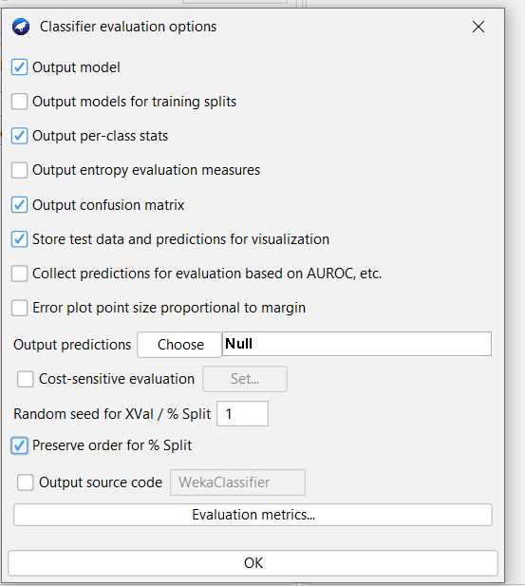
Classifier Evaluation

Slide 18
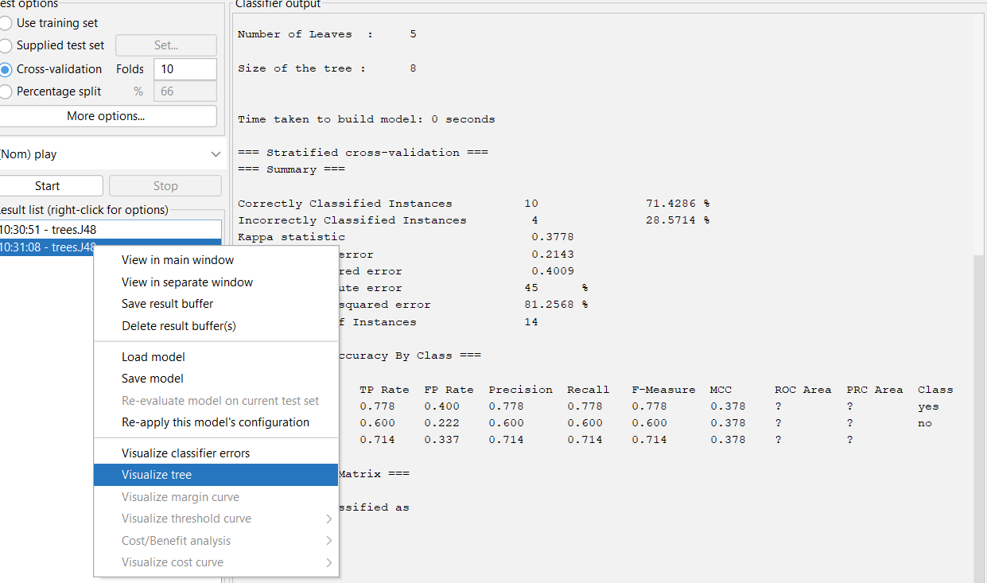
Visualization Tree

Slide 19
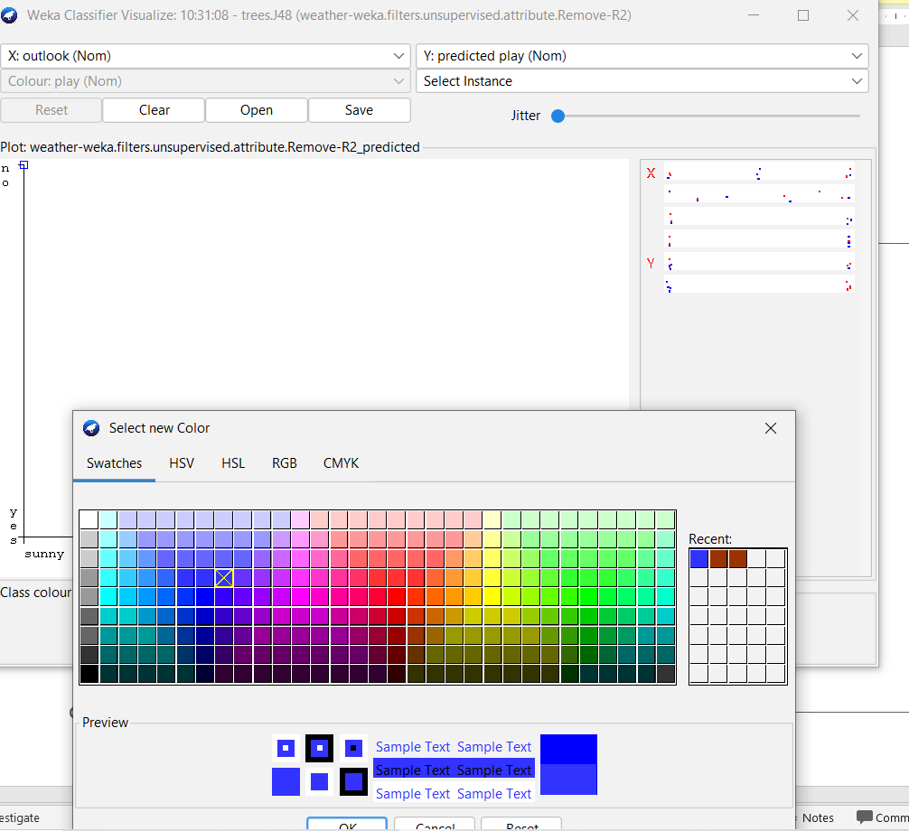
Weka Classifier Visualize

